Slide 1





Java MVC Frameworks
AJAX, Spring Data REST
Java MVC Frameworks
SoftUni Team
Technical Trainers
Software University
http://softuni.bg

Slide 2

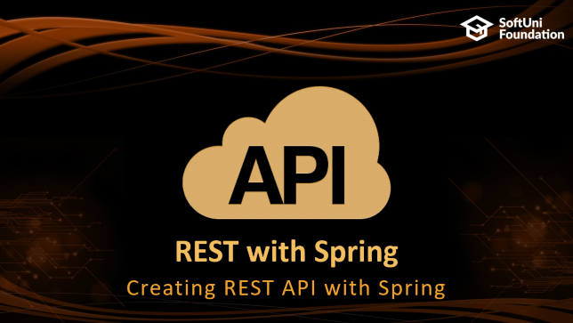
Table of Contents

Slide 3
Questions
sli.do #java-web

Slide 4

AJAX and JQuery
Consuming JSON

Slide 5

What is AJAX?
AJAX == Asynchronous JavaScript And XML
Technique for background loading of dynamic content / data
Web pages / apps load data from the Web server and render it
Two types of AJAX
Partial page rendering
Load HTML fragment + show it in a <div>
JSON service
Load JSON object and display it with JavaScript / jQuery

Slide 6




AJAX: Workflow
1. HTTP request (initial page load)
2. HTTP response (HTML page)
AJAX request
UI Interaction
AJAX response (asynchronous)
AJAX handler
Returns data as JSON / HTML
Web Client
Web Server
Modify the page DOM

Slide 7
jQuery Selectors
Some of the jQuery selectors:
- gets the element with attribute id="title"
- gets the elements with attribute class="m-0"
- selects all of the <a> tags
The selectors return jQuery object/collection
You can create complex selections
$("#title");
$(".m-0");
$("a");

Slide 8
jQuery AJAX
jQuery dramatically simplifies how developers make AJAX calls
Supports GET and POST requests:
Cross-Browser support
Load JSON, XML, HTML or even scripts
Simple API
Allows parts of a page to be updated

Slide 9
jQuery Get and Post
Example GET request:
Example POST request:
$.get("/games/5").done(function (data) {
alert(JSON.parse(data));
});
$.post(url, data).fail(function () {
alert("An error occurred. Please, try again later.");
});

Slide 10
jQuery Get JSON
Sending a request that will return JSON:
let url = "/games/" + id + "/info";
$.getJSON(url).done(function (info) {
$("#title").text(info.title);
$("#trailer").attr("src", "https://www.youtube.com/embed/" + info.trailer);
});

Slide 11

REST with Spring
Creating REST API with Spring

Slide 12
Response Body on MVC Controller
Returning plain-text in MVC controller:
@GetMapping("{id}/info")
@ResponseBody
public String getInfo(@PathVariable Long id){
GameInfoView gameInfo = this.gameService.getInfoById(id);
return new Gson().toJson(gameInfo);
}

Slide 13
Response Status
Setting the correct Response Code
@GetMapping("{id}/info")
@ResponseBody
@ResponseStatus(HttpStatus.OK)
public String getInfo(@PathVariable Long id){
GameInfoView gameInfo = this.gameService.getInfoById(id);
return new Gson().toJson(gameInfo);
}

Slide 14
REST Controllers
@RestController is essentially @Controller + @ResponseBody:
@RestController
public class OrderController {
@GetMapping("{id}/info")
public String getInfo(@PathVariable Long id){ ...
}
}

Slide 15
Response Entity
Controlling the entire response object:
The ResponseEntity<> object allows you to change the response body, response headers and response code
@GetMapping("{id}/title")
public ResponseEntity<String> getTitle(...){
...
return new ResponseEntity.ok(game.getTitle());
}

Slide 16
Spring Data REST
Include Maven Dependency
Spring Data REST scans your project and provides REST API for your application using HAL as media type
<dependency>
<groupId>org.springframework.boot</groupId>
<artifactId>spring-boot-starter-data-rest</artifactId>
</dependency>

Slide 17
Configuring Repositories
You can configure repository settings using the @RepositoryRestResource annotation:
@RepositoryRestResource(path = "gameIssues")
public interface IssueRepository extends JpaRepository<Issue, Long> {
Issue getById(@Param("id") Long id);
List<Issue> getAllByOrderByDateDesc();
}

Slide 18

Summary
AJAX sends asynchronous HTTP requests from JS
jQuery simplifies how developers use AJAX
Actions in controllers can return plain text via @ResponseBody
@RestController is used when all actions will return JSON or XML.
Spring Data REST uses Spring HATEOAS to automatically expose resources for entities managed by Spring Data repositories

Slide 19







Java MVC Frameworks – Web API
https://softuni.bg/courses/java-mvc-frameworks-spring

Slide 20
License
This course (slides, examples, demos, videos, homework, etc.) is licensed under the "Creative Commons Attribution-NonCommercial-ShareAlike 4.0 International" license

Slide 21





Trainings @ Software University (SoftUni)
Software University – High-Quality Education, Profession and Job for Software Developers
softuni.bg
Software University Foundation
http://softuni.foundation/
Software University @ Facebook
facebook.com/SoftwareUniversity
Software University Forums
forum.softuni.bg

